Slide 1
Welcome to 3-202!

Slide 2
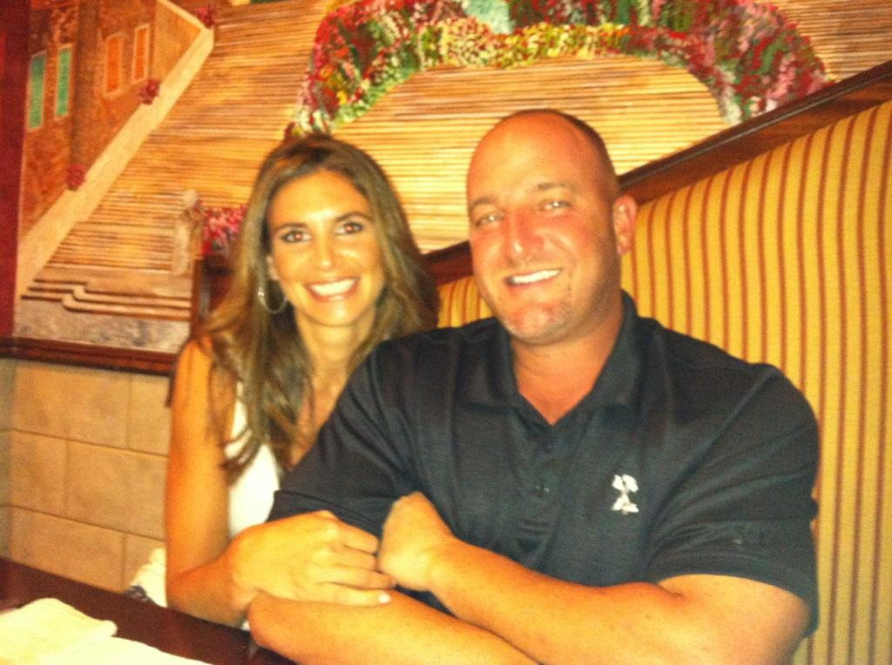
Ms. San Antonio
Education
SUNY Cortland
Queens College
P.S. 239- 5th grade
P.S. 154

Slide 3
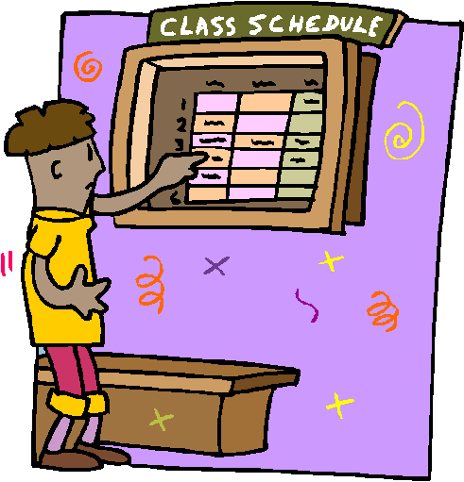
Routines
Morning
Afternoon
Daily Schedule
Birthdays

Slide 4
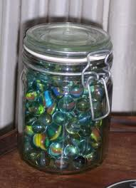
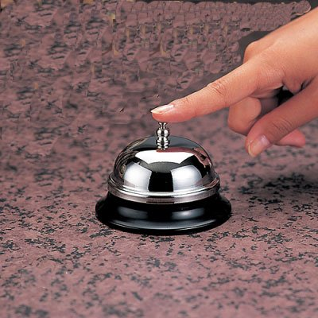
Behavior
Class:
Marble Jar
Fun Friday
Bell/Count down from 5
Group:
Table points
Individual:
Writer and Mathematician of the month
Ticket system
Positive reinforcement

Slide 5
Reading
20 minutes every night
Fill out reading log with parent signature
Respond to reading
Post its
Use Suggestions for Reading Response sheet as a guide
Math
A page from the Study Links book or an alternative worksheet
Practice multiplication/division/addition/subtraction facts

Slide 6
Homework
Writing
3-5 nights a week (one page long)
Might be an entry or a continuation from the class lesson
Science
Will have homework due every Wednesday (storing the binder at home)
Homework folder:
Empty every night (Return to school or keep home)

Slide 7
Reading
Date of Exam: April 16th, 17th, 18th
Leveling:
Currently an M is on grade level
End of 3rd grade: P
New Common Core Standards:
Comparing & Contrasting different sources of information
Reading and analyzing informational texts to discuss claims, arguments, and evidence
Answer a question and respond with text evidence
Read more complex text with higher level vocabulary
Share ideas and respond, critique, and analyze other students’ ideas

Slide 8
Reading Units of Study
September- Building a Reading Life
October- Following Characters into Meaning
November- Series Book Clubs
December- Nonfiction Reading: Expository Text
January- Biography Book Clubs
February- Informational Reading: Reading, Research and Writing in the Content Areas
March/April- Test Preparation
April/May- Social Issues Book Clubs

Slide 9
Test Dates: April 24th, 25th, 26th
New Common Core Standards:
Teaching less but more in depth
Multi-step problems that are open-ended
Testing mathematic vocabulary by asking students to apply their understanding of vocabulary
Problems that ask students to choose the appropriate tool and apply mathematical concepts

Slide 10
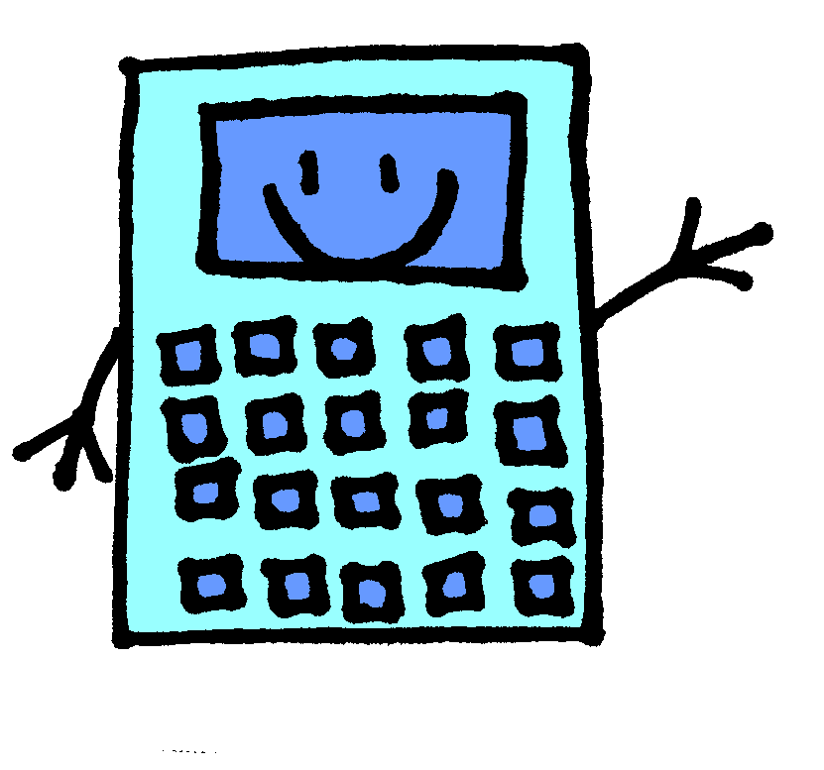
Math
Operations and Alebraic Thinking:
Multiply & Divide whole numbers
Solve word problems with two-steps
Identify patterns
Round numbers to the nearest 10 and 100
Fluently add and subtract within 1,000
Number and Operation-Fractions
Understand fractions
Understand fractions on a number line
Explain equivalence of fractions

Slide 11
Math
Measurement & Data
Tell and write time to the nearest minute
Solve word problems involving addition and subtraction of time intervals in minutes
Measure and estimate liquid volumes and masses of objects
Solve one-step problems involving masses or volumes
Draw a scaled picture graph and bar graph and solve one- and two-step problems
Measure using rulers marked with halves and fourths of an inch and represent date making a line plot
Recognize and understand area
Solve real word and mathematical problems involving perimeter of polygons

Slide 12
Math
Geometry
Understand that shapes in different categories may share attributes
Partition shapes into parts with equal areas. Express each part as a unit fraction of the whole

Slide 13
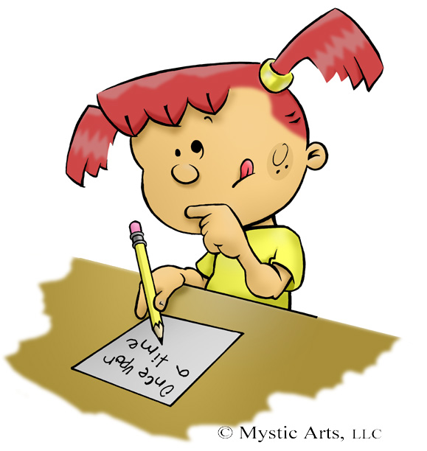
Writing
New Common Core Standards:
Responding based on a text, supporting it with evidence
Comparing two different text on the same topic
Will be graded on grammar, punctuation, capitalization and spelling!

Slide 14
Writing Units of Study
Unit 1: Personal Narrative
Unit 2: Realistic Fiction
Unit 3: Informational Writing
Unit 4: Poetry
Unit 5: Persuasive Review and Writing about Reading
Unit 6: Test Prep
Unit 7: Writing to Make a Real World Difference
Unit 8: Informational Writing- writing in content areas

Slide 15
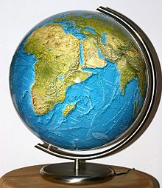
Social Studies
Units of Study:
Communities
Geography
Asia
Africa
South America

Slide 16
What can you do to help?
Monitor the completion of their homework
Get them involved in real world experiences- park, zoo, etc. and have them talk and write about it
Practice automaticity of math facts using flashcards
Practice word problems
Check their writing homework and correct grammar, spelling, punctuation, and capitalization so they learn from their mistakes

Slide 17
Field Trips
Tentative Trips:
Queens Zoo
Queens County Farm (Learn how clothing is made)
Theatre show
Botanical Gardens (Food from Around the World)

Slide 18
Parent/Teacher Contact
Email
I will have a distribution list set up and send out important information through email
My email: DSanAntonio@schools.nyc.gov
Write a Note
Set up a meeting with me
Notices sent home
Math grades
Reading levels
Things happening around the school
My Website: www.dsanan.weebly.com

